Slide 1
TOPICS COVERED
DATA MANIPULATION ALIAS
COMPLEX QUERIES
sub queries
joins
unions
DCL
TCL
SYNONYMS and ALIASES
Notes:
In this session let’s discuss about the retrieval operations done by SELECT statement of the DML

Slide 2
ALIAS - Column Aliases
Heading of a column can be changed while displaying data in a select statement, in order to make the display more meaningful.
A column Alias gives a column an alternative name for that attribute in the o/p.
The Alias has to be specified after the column in the select list.
The scope of the alias name is only with in that SQL statement.
Notes:
The next topic is about column Alias. i.e., We are going to discuss about how to give an alias name to a column in the SELECT statement.
What is an column alias?
Giving an alternate name to column that we are retrieving from the table.
Heading of a column can be changed while displaying data in a select statement, in order to make the display more meaningful.
The column alias specified in the SELECT statement is applicable to the result set and not to the base table.

Slide 3
ALIAS - Column Aliases
The Column Alias name can be given in two ways
The new ALIAS name can be written along with column name separated by a single space
  SELECT EMPNO EMPLOYEENUMBER, SALARY FROM EMP;
Column name
ALIAS NAME
Notes:
Let’s discuss with example:
Example :
SELECT EMPNO EMPLOYEENUMBER, SALARY FROM EMPLOYEE;
In the above query the field (column) EMPNO is given an alternate name as EMPLOYEENUMBER and when it the query is executed, the result set will be displayed as EMPLOYEENUMBER instead of EMPNO as well as the salary field will also be displayed from the EMPLOYEE table.
The alias name given to EMPNO is applicable only to the Current SELECT statement and not to the base table.
While giving the alias name to a column if it contains embedded spaces then the alias name should be enclosed within Double quotes.
For Example:
SELECT EMPNO “EMPLOYEE NUMBER”, SALARY FROM EMPLOYEE;
In the above query the alias name is EMPLOYEE NUMBER, which has space in name and hence it should be enclosed by Double quotes.

Slide 4

2. The new ALIAS name can be written along with column name separated by a word “AS”.
  SELECT EMPNO AS EMPLOYEENUMBER,
  SALARY FROM EMP;
ALIAS NAME
Notes:
Let’s discuss with example:
Example :
SELECT EMPNO EMPLOYEENUMBER, SALARY FROM EMPLOYEE;
In the above query the field (column) EMPNO is given an alternate name as EMPLOYEENUMBER and when it the query is executed, the result set will be displayed as EMPLOYEENUMBER instead of EMPNO as well as the salary field will also be displayed from the EMPLOYEE table.
The alias name given to EMPNO is applicable only to the Current SELECT statement and not to the base table.
While giving the alias name to a column if it contains embedded spaces then the alias name should be enclosed within Double quotes.
For Example:
SELECT EMPNO “EMPLOYEE NUMBER”, SALARY FROM EMPLOYEE;
In the above query the alias name is EMPLOYEE NUMBER, which has space in name and hence it should be enclosed by Double quotes.

Slide 5
ALIAS - Column Aliases
The Alias headings are also converted to uppercase in the o/p list, and unless it is enclosed in double quotes cannot contain spaces.
  SELECT EMPNO EMPLOYEENUMBER,
  SALARY FROM EMP;
If the aliases contain embedded spaces it should be enclosed within double quotation marks
SELECT EMPNO “EMPLOYEE NUMBER”,
SALARY FROM EMP;
Notes:
Let’s discuss with example:
Example :
SELECT EMPNO EMPLOYEENUMBER, SALARY FROM EMPLOYEE;
In the above query the field (column) EMPNO is given an alternate name as EMPLOYEENUMBER and when it the query is executed, the result set will be displayed as EMPLOYEENUMBER instead of EMPNO as well as the salary field will also be displayed from the EMPLOYEE table.
The alias name given to EMPNO is applicable only to the Current SELECT statement and not to the base table.
While giving the alias name to a column if it contains embedded spaces then the alias name should be enclosed within Double quotes.
For Example:
SELECT EMPNO “EMPLOYEE NUMBER”, SALARY FROM EMPLOYEE;
In the above query the alias name is EMPLOYEE NUMBER, which has space in name and hence it should be enclosed by Double quotes.

Slide 6
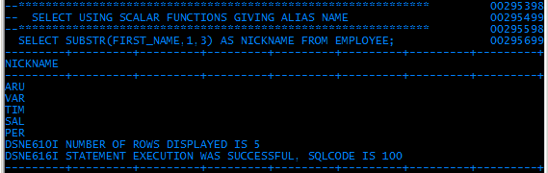

ALIAS - Column Aliases

Slide 7
THE CONCATENATION OPERATOR
|| allows columns to be linked to other columns,constant values or arithmetic expressions to result in a single character column.
Example:
SELECT FNAME||LNAME “EMPLOYEE NAME” FROM EMP;
O/P
        EMPLOYEE NAME
        LINDAGOODMAN
        SIDNEYSHELDON
Notes:
Next we are going to discuss about the Concatenation operator used in SELECT statement.
The Concatenation operator is ||(OR) symbol which is used to link the values of one column with the other column.
Example is:
SELECT FNAME||LNAME “EMPLOYEE NAME” FROM EMP;
In the above query the value of the column FNAME and LNAME of the EMP table are concatenated together and displayed under the name as “EMPLOYEE NAME” in the result set.
Output is:
EMPLOYEE NAME
LINDAGOODMAN
SIDNEYSHELDON
Where LINDA and SIDNEY are the values of FNAME and GOODMAN, SHELDON are the values of LNAME.

Slide 8
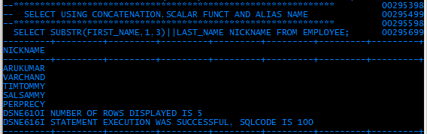
THE CONCATENATION OPERATOR

Slide 9
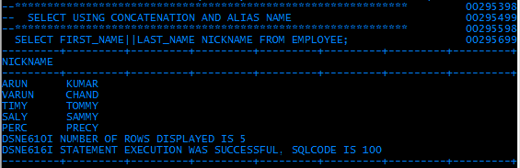
THE CONCATENATION OPERATOR

Slide 10
COMPLEX SQL’S
One terms a SQL to be complex when data that is to be retrieved comes from more than one table.
Important Note:
A table can be referred and considered as more than one table by giving it more than one alias name.
The tables can be different.
Notes:
COMPLEX SQL':
When ever the data retrieved from more than one table then the query written will be of Complex.
There are 2 ways of coding Complex SQL. They are:
1) Subqueries 2) Joins

Slide 11
Complex SQL’s
SQL provides THREE ways of coding a complex SQL
1.Sub queries
2.Joins - non related tables
3. unions
Notes:
COMPLEX SQL':
When ever the data retrieved from more than one table then the query written will be of Complex.
There are 2 ways of coding Complex SQL. They are:
1) Subqueries 2) Joins

Slide 12
SUBQUERIES
Nested Select statements(16 levels max)
A query in side a query.
Specified using the IN (or NOT IN) predicate, equality or non-equality predicate(‘=‘ or ‘<>‘) and comparative operator(<, <=, >, >=)
When using the equality, non-equality or comparative operators, the inner query should return only a single value
The nested loop statements gives the user the flexibility for querying multiple tables
Notes:
Subqueries :
- Can be very useful when rows are needed to be selected from a table with a condition that depends on the data in the table itself.
- A query that is written within another query.
- It is also called as Nested SELECT statement.
- When using the equality, non-equality or comparative operators, the inner query should return only a single value.
- Correlated (the nested select statement refers back to the columns in previous select statements) & Non Correlated Sub queries.
Some of the Examples are:
E.g. SELECT CUST_NO, CUST_NAME
FROM CUSTOMER
WHERE ORDER_NO IN (SELECT ORDER_NO FROM ORDER WHERE NO_PRODUCTS <5);
E.g. SELECT CUST_NO, CUST_ADDR
FROM CUSTOMER
WHERE ORDER_NO =
(SELECT ORDER_NO FROM ORDER
WHERE NO_PRODUCTS = 5);

Slide 13
SUBQUERIES
SUBQUERIES
correlated
Non- correlated
the nested select statement
refers back to the columns in previous select statements
TOP-BOTTOM – UP approach
the nested queries in which the inner query completes first and based on that the outer query functions.
BOTTOM - UP approach

Slide 14
SUB QUERIES
Non correlated
Locate the Project information of Employee whose first name is ‘TIMY’
SELECT PROJNO , PROJNAME
  FROM DSN8710.PROJ
  WHERE PROJID =
  ( SELECT PROJID
  FROM DSN8710.EMPLOYEE
  WHERE FIRST_NAME =
  ‘TIMY’);
Notes:
Let’ s discuss with examples:
Example 1:
SELECT PROJNO , PROJNAME FROM DSN8710.PROJ WHERE RESPEMP =( SELECT EMPNO FROM DSN8710.EMP
WHERE FIRSTNME = 'CHRISTINE');
The above query is used to Locate the Project information of Employee whose first name is ‘Christine’.
In this example first the inner query will be executed and then the outer query will be executed.
Example 2:
SELECT DEPTNO , DEPTNAME FROM DSN8710.DEPT WHERE DEPTNO IN ( SELECT WORKDEPT FROM DSN8710.EMP
WHERE HIREDATE IN ('1947-05-05', '1963-12-05'));
The above query is used to Locate the dept information of all employees with a specific Hire Date.

Slide 15
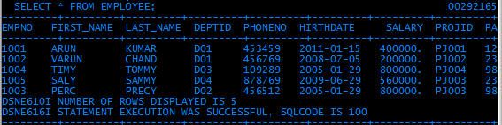
Content of the tables EMPLOYEE

Slide 16
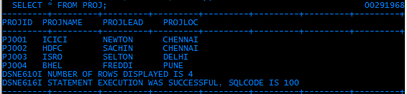
Content of the tables PROJ

Slide 17
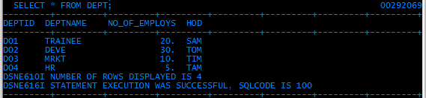
Content of the tables DEPT

Slide 18
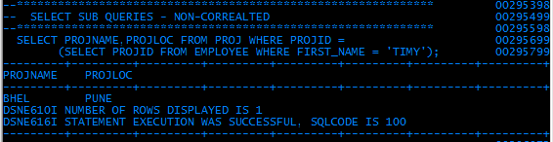
Ex: Non- correlated Sub query.
Selecting from proj table based on a value in employee table
INNER query
OUTER query

Slide 19
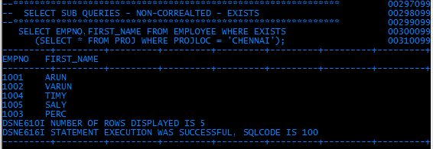
Non- correlated Sub query using EXISTS

Slide 20
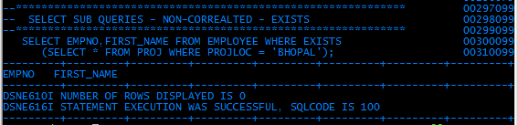
Non- correlated Sub query using EXISTS

Slide 21
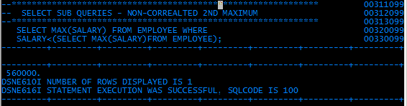
Non- correlated Sub query –
Referring to the same table in both the queries
EMPLOYEE table is referred in both the queries

Slide 22
CORRELATED SUB QUERIES
A specialized form is Correlated Sub query - the nested Select statement refers back to the columns in previous select statements
It works on Top-Bottom-Top fashion
Ex: to find the Nth maximum salary from a table.

Slide 23
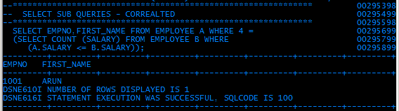
CORRELATED SUB QUERIES

Slide 24
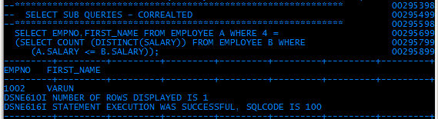
CORRELATED SUB QUERIES
- using DISTINCT

Slide 25
JOINS –
(INTERSECTION)
Main feature which distinguished relational from non relational systems
Used when a SQL query requires data from more than one table
Rows in one table may be joined to rows in another table according to common values existing in corresponding columns
Two main types of joins
  INNER Joins
  OUTER Joins
Notes:
There are 2 two ways to retrieve the data from more than one table. They are:
1) JOINS 2) UNION
Let’s discuss about the first method.
JOINS:
- Is used to retrieve information from more than one table.
- Rows in one table may be joined to rows in another table according to common values existing in corresponding columns.
There are 2 types of JOINS. They are:
1) INNER JOIN 2) OUTER JOIN

Slide 26
JOINS –
(INTERSECTION)
JOINS
INNER
OUTER
LEFT
RIGHT
FULL
Based on the common values in both the tables
Ex: A intersection B
Based on the common values in both the tables
Plus extras in the left table
Based on the common values in both the tables
Plus extras in the right table
Based on the common values in both the tables
Plus extras from the left table and then from right table
Notes:
There are 2 two ways to retrieve the data from more than one table. They are:
1) JOINS 2) UNION
Let’s discuss about the first method.
JOINS:
- Is used to retrieve information from more than one table.
- Rows in one table may be joined to rows in another table according to common values existing in corresponding columns.
There are 2 types of JOINS. They are:
1) INNER JOIN 2) OUTER JOIN

Slide 27
JOINS
Old method of writing a join
SELECT empname, deptname
FROM emp, dept
WHERE emp.deptno = dept.deptno
ANSI SQL 1999 standard
SELECT empname,deptname
FROM emp
Join dept
On emp.deptno = dept.deptno
Notes:
Let’s see the new method of writing a JOIN query.
Example:
SELECT empname,deptname FROM emp Join dept On emp.deptno = dept.deptno;
The query which was given in the previous slide can be written like this as per the ANSI SQL 1999 standard.
In the above query JOIN is the keyword used and instead of JOIN we can also use INNER JOIN.

Slide 28
Using TABLE ALIASES
If table names need to be typed repeatedly, it can get tedious
Temporary Labels or Aliases can be used for table names in WHERE clause
This remain valid for current SELECT clause
Can be up to 30 character in length
If a table alias is used for a table name in FROM clause then that alias must be substituted for the table name throughout the SELECT statement.
Notes:
Specifying Table alias while performing JOIN operation.
Why Table alias?
- If table names need to be typed repeatedly, it can will be tedious. So in order to avoid that we can specify alias name for the table in a short format for user convenience.
- Such ALIAS name for the table remains valid for the current SELECT statement.
- The alias name of the table can be up to 30 character length.

Slide 29
INNER JOIN
SELECT e. empname,d.deptname
FROM employee e
JOIN dept d
ON e. deptno = d. deptno
SELECT e. empname, d.deptname
FROM employee e
IINER JOIN dept d
ON e. deptno = d. deptno
Note: Default is INNER joins
Notes:
Example is:
SELECT e.empname, d.deptname FROM emp e JOIN dept d ON e.deptno = d.deptno;
In the above query ‘e’ is table alias name for the Emp table and ‘d’ is the alias name for the ‘dept’ table.

Slide 30
Employee Table - sample
EMPNO | EMPNAME | DEPTNO | SALARY
E001 | ABC | D001 | 12000
E002 | DEF | D002 | 15000
E003 | GHI | D001 | 11000
E004 | UVW | NULL | 17000
DEPT TABLE – sample
DEPTNO | DEPTNAME
D001 | Finance
D002 | Accounts
D003 | Sales
Notes:
In this slide Employee table (named Emp) and Department table (named dept) are given.
Where in EMP table there are 4 fields. They are: EMPNO, EMPNAME, DEPTNO, SALARY and in
DEPT table there 2 fields, namely DEPTNO and DEPTNAME.
In the above two table there is a common field named DEPTNO and using this the data will retrieved from both the tables.

Slide 31
INNER JOIN
SELECT e. empname, d.deptname
FROM employee e
IINER JOIN dept d
ON e. deptno = d. deptno
EMPNAME | DEPTNAME
ABC | Finance
DEF | Accounts
GHI | Finance
So we get only those rows which satisfy the condition e.deptno = d.deptno This join is called “INNER JOIN”

Slide 32
OUTER JOIN
RIGHT
SELECT e.empname,d.deptname
FROM employee e
Right outer JOIN dept d
ON e.deptno = d.deptno
EMPNAME | DEPTNAME
ABC | Finance
DEF | Accounts
GHI | Finance
 | Sales
We get those rows which satisfy the condition
e.deptno = d.deptno and non-matching rows from the right side table.In this case “Dept”. This join is called “RIGHT OUTER JOIN”
Notes:
In this slide a type of OUTER Join is explained.
OUTER JOIN:
It returns rows from 2 or more tables independent of matching or non-matching values.
There are 3 types of Outer Join. They are:
i) RIGHT OUTER JOIN ii) LEFT OUTER JOIN iii) FULL OUTER JOIN
Let’s now discuss about RIGHT OUTER JOIN.
What is RIGHT OUTER JOIN?
It includes the rows that satisfies the condition from both the tables and the non-matching rows from the right side table will also be displayed.

Slide 33
OUTER JOIN
LEFT
SELECT e.empname,d.deptname
FROM employee e
LEFT outer JOIN dept d
ON e.deptno = d.deptno
EMPNAME | DEPTNAME
ABC | Finance
DEF | Accounts
GHI | Finance
UVW
We get those rows which satisfy the condition e.deptno = d.deptno and non-matching rows from the left side table.In this case “Emp”. This join is called “LEFT OUTER JOIN”
Notes:
In this slide LEFT OUTER JOIN is explained with an example.
LEFT OUTER JOIN:
It includes the rows that satisfies the condition from both the tables and the non-matching rows from the left side table.

Slide 34
OUTER JOIN
FULL
SELECT e.empname,d.deptname
FROM emp e
FULL outer JOIN dept d
ON e.deptno = d.deptno
EMPNAME | DEPTNAME
ABC | Finance
DEF | Accounts
GHI | Finance
UVW
 | SALES
We get those rows which satisfy the condition e.deptno = d.deptno and non-matching rows from the left side and right side table. This join is called “FULL OUTER JOIN”
Notes:
In this slide FULL OUTER JOIN is explained with an example.
FULL OUTER JOIN:
It includes the rows that satisfies the condition from both the tables as well as the non-matching rows from the left and right side table. i.e., It is the combination of LEFT OUTER JOIN + RIGHT OUTER JOIN.

Slide 35
UNION
The UNION operation combines two sets of rows into a single set composed of all the rows in either or both the original sets.
Notes:
The next method to retrieve the data from more than one table is UNION.
UNION:
- We can combine two or more SELECT statements to form a single result table.
- You can use UNION to eliminate duplicates when merging lists of values obtained from several tables.

Slide 36
RULES FOR UNION
UNION
The two sets must contain the same number of columns
Each column in the first set must be either of the same data type as the corresponding column of the second set or convertible to the same data type as the corresponding column of the second set
Notes:
This slide states what are the rules to be followed while using UNION.
Rules for UNION:
i) Number of columns retrieved from the first table should be equal to the number of columns retrieved in second table.
ii) Datatype of the column should be the same.

Slide 37
Example
UNION
PERM-EMP
Empno
Empname
EmpAddress
EmpPhone
Salary
TEMP-EMP
TEmpno
TEmpname
TEmpAddress
TEmpPhone
Wages
Notes:
This slide shows two tables that are going to be used for UNION operation.
- First table contains the list of permanent employees and the name of the table is PERM-EMP and it has 5 fields namely Empno, Empname, EmpAddress, EmpPhone and Salary.
- Second table contains the list of temporary employees and the name of the table is TEMP-EMP and it has 5 fields namely TEmpno, TEmpname, TEmpAddress, TEmpPhone and Wages.

Slide 38
Example Contd.
UNION
Someone wants the address and phone of all the employees of the company irrespective of whether they are temporary or permanent
Select empno, empname, empaddress, empphone
from perm-emp
Union
Select tempno, tempname, tempaddress, tempphone
from temp-emp ;
Notes:
Let’s discuss an example:
In a company there are permanent employees and temporary employees and irrespective of whether they are temporary or permanent , Someone wants the address and phone of all the employees of the company.

Slide 39
UNION ALL
Union eliminates duplicates. So if we want all the rows to be printed then we have to use “UNION ALL”
Notes:
In this slide the concept on UNION ALL is explained.
Generally if we use UNION, the duplicates will be eliminated in the result set and in order to retain the duplicate values use UNION ALL instead of UNION.

Slide 40
DB2 PRIVILEGES
IMPLICIT – Automatic privileges for CREATOR of object
EXPLICIT – Specific privilege provided by GRANT and REVOKE SQL Statement

Slide 41
DB2 PRIVILEGES
1. Implicit Privileges on Table
All DML
ALTER and DROP of table
CREATE and DROP indexes
References – referential constraints
Run certain DB2 utilities

Slide 42
2. Explicit privilege
DCL (Data Control Language)
3. DCL (Data Control Language)
DB2 PRIVILEGES
Explicit privileges can be given to the user by the DCL Statements
  GRANT
  REVOKE

Slide 43
DB2 PRIVILEGES
2. Explicit – DCL - GRANT
GRANT
Grants privileges on different DB2 objects such as the Tables, Views, Plans, Packages, Databases etc. to the required set of users.
Is used to grant Use privileges to user on requirement.
Is also used to grant system privileges to select few users.
User with a SYSADM privilege will be responsible for overall control of the system.
Operation specific and Attribute (column) specific privilleges can be granted.
Notes:
Let’s discuss about GRANT now:
GRANT command is used to assign the privileges to the other user so that they can access the DB2 objects.
SYSADM (System Administration) is the Bundled (Administrative) privilege that allows the holder to execute any operation that the system supports.

Slide 44
DB2 PRIVILEGES
2. Explicit – DCL - GRANT
Syntax : GRANT <privileges> TO <users/PUBLIC> [WITH GRANT OPTION]
E.g. GRANT SELECT, UPDATE(NAME, NO)
ON Table EMPL To A, B, C (or PUBLIC);
Note: Select operation is granted for all the attributes to users A, B and C. But, Update operation is allowed only for NAME and NO attributes.
Eg. Grant ALL ON TABLE EMPS TO USER1
All the possible operation on all the attributes of table EMPS are granted to USER1.
Notes:
Let’s discuss about GRANT now:
GRANT command is used to assign the privileges to the other user so that they can access the DB2 objects.
SYSADM (System Administration) is the Bundled (Administrative) privilege that allows the holder to execute any operation that the system supports.

Slide 45
DB2 PRIVILEGES
2. Explicit – DCL - GRANT
  * Some table (or View) privileges are :
    - Select, Update, Delete and Insert.
    * Privileges specific to Tables are:
    - Alter & Index (create).
    * There are no specific DROP privileges;
    * The table can be dropped by its owner or a SYSADM.
  * A user having authority to grant privilege to another, also has the authority to grant the privilege with “with the GRANT Option”.
Notes:
Similarly all the DML statements (SELECT, UPDATE, DELETE & INSERT) privileges can be assigned to the users.
There is no specific DROP privilege instead the table can be dropped by its owner or by the System Administration privilege.
When a user is granting the privileges to the other user WITH GRANT OPTION then that user can also assign the obtained privileges to some other user.
For Example: If User1 is granting the SELECT & INSERT privilege on EMP table to User2 using WITH GRANT OPTION then User2 can also grant those privilege to some other users.

Slide 46
DB2 PRIVILEGES
2. Explicit – DCL - REVOKE
Revoke is primarily used to revoke ( call back) the privileges given to a user on specific Objects.
The user granting the privileges has the authority to Revoke also.
It is not possible to be column specific when revoking an Update privilege.
It is possible to be user specific when revoking a privilege granted.
Notes:
REVOKE is to take away the permissions on database objects. i.e., What are all the privileges that was assigned can be taken back from that user using REVOKE command. i.e., The User who has granted the privileges to the User only has the rights to take back that privileges.
Note: While revoking an UPDATE privilege from a user, it is not possible to be column specific.

Slide 47
DB2 PRIVILEGES
2. Explicit – DCL - GRANT
Removing privileges on Table from the user
REVOKE SELECT
ON TABLE EMP,DEPTS FROM CMAP112;
REVOKE ALL ON TABLE EMP FROM USER1;
REVOKE ALL ON TABLE EMP FROM PUBLIC;

Slide 48
4. TCL
(TRANSACTION CONTROL LANGUAGE)
COMMIT
ROLLBACK

Slide 49
Commit Transaction
4. TCL
(TRANSACTION CONTROL LANGUAGE)
    Indicates successful end of a unit work
    What ever changes done till this command is given will be written in the actual memory.
    All page LOCKS released.
    TABLE (Space) Locks released if Release (Commit) on BIND.
    Cursor is Closed.
    Syntax : COMMIT ;
Notes:
Now we can discuss What is Commit and its significance?
A successful end-of-transaction is signaled by the use of Commit statement.
Once Commit operation is performed all updates made by the program will be written to the disk.
After Commit the LOCKS on the pages will be released and the Table locks will be released if we had specified RELEASE(COMMIT) parameter in the Bind Process.
As soon as the operation is committed, the cursor will be closed automatically.

Slide 50
Rollback Transaction
4. TCL
(TRANSACTION CONTROL LANGUAGE)
Current unit of work abandoned
Changes to data since last COMMIT are undone.
ALL Page Locks released.
TABLE (Space) Locks released if Release (Commit) on BIND.
Cursor Closed.
Syntax :
ROLLBACK;
Notes:
The second TCL statement that we are going to discuss is ROLLBACK.
An Unsuccessful end-of transaction is signaled by means of ROLLBACK statement.
Once the operation is rollback, all updates made by the program are undone and all the Page locks will be released.
After ROLLBACK the Table locks will be released if we had specified RELEASE(COMMIT) parameter in the Bind Process.
As soon as the operation is rollback, the cursor will be closed.

Slide 51
SYNONYMS AND ALIASES
These are alternate names for tables and views.
Notes:
these are alternate names for tables and views. Synonyms can only used to refer to
objects that exist locally, but aliases can be used to refer to remote objects as well as local
objects.
Synonym. In SQL, an alternative name for a table or view. Synonyms can only be used
to refer to objects at the subsystem in which the synonym is defined.
Alias. An alternate name that can be used in SQL statements to refer to a table or view
in the same or a remote DB2 subsystem.
An alias, like a synonym, is a DB2 object that represents a table or a view. Unlike a
synonym, an alias can represent remote tables and views, and it can be used by anyone,
not just its creator. In addition, you do not need DB2 authority to use it. However,
you must have authority to use the table or view that it represents.
A reference to an alias could a one-two, or three-part name. The rules are basically the
same as those used to refer to a table or view.
A one-part name refers to a local alias. If the statement being executed is dynamic, the
owner of the alias is your current SQL authorization ID. Otherwise, it is the value
specified on the AQUALIFIER bind option. If a value is not specified on the
QUALIFIER bind option, then the owner of your package or plan is the qualifier of the
alias.
Example : A reference to EMP in a n interactively executed query could refer to the
alias SMITH.EMP if your current SQL authorization ID is SMITH.
A two-part name also refers to a local alias. As is true for a table or view, the first
qualifier identifies the owner.
Example : JONES.NEWTAB could refer to an alias named NEWTAB and owned by
JONES.
A three-part name could refer to either a local or a remote alias. As is true for a table or
view, the first qualifier specifies the location, and the second qualifier identifies the
owner. If the alias is remote, it must represent a table or view at its own location.
Example : A statement issued at the SAN_FRANCISCO subsystem refers to an alias at
DALLAS. The alias referred to must represent a table or view at DALLAS and
nowhere else.
Assume now that the alias SMITH.DALEMP has been defined at your local subsystem
for the table DALLAS.DSN 8230.EMP. You could then substitute the alias for this
table name. The result would look like this :
SELECT LASTNAME, MIDINIT, FIRSTNME, EMPNO, WORKDEPT FROM
SMITH.DALEMP
WHERE LASTNAME LIKE ‘%SON’;
An advantage to using a locally defined alias is that the SQL statements in which it
appears need not be changed if the table or view for the alias is either moved to another
location or renamed. To make these statements valid, drop the original alias and create
it again, and, for embedded SQL, rebind the program in which it appears.
The option of referencing a table or view by an alias or a synonym is not explicitly shown
in the syntax diagrams or mentioned in the description of SQL statements. Nevertheless,
an alias or a synonym can be used wherever a table or view can be referred to in an
SQL statement, with two exceptions: an alias cannot be used in CREATE ALIAS, and
a synonym cannot be used in CREATE SYNONYM. If an alias is used in CREATE
SYNONYM, it must identify a table or view at the current server. The synonym is
defined on the name of that table or view. If a synonym is used in CREATE ALIAS,
the alias is defined on the name of the table or view identified by the synonym.
The effect of using an alias or a synonym in an SQL statement is that of text substitution.
For example, if A is an alias or synonym for table Q.T, one of the steps involved in the
preparation of SELECT *FROM A is the replacement of ‘A’ by ‘A.T’ .
The differences between aliases and synonyms are a s follows :
SYSADM or SYSCTRL authority or the CREATE ALIAS privilege is required to
define an alias. No authorization is required to define a synonym.
An alias can be defined on the name of a table or view, including tables and
views that are not at the current server. A synonym can only be defined on the name of
a table or view at the current server.
An alias can be defined on an undefined name. A synonym can only be defined
on the name of an existing table or view.
Dropping a table or view has no effect on its aliases. But dropping a table or
view does drop its synonyms.
An alias is a qualified name that can be used by any authorization ID. A synonym
is an unqualified name that can only be used by the authorization ID that created it.
An alias defined at one DB2 subsystem can be used at another DB2 subsystem.
A synonym can only be used at the DB2 subsystem where it is defined.
When an alias is used, an error occurs if the name that it designates is undefined
or is the name of an alias at the current server. (Note, however, that the name can
designate an alias defined at another server if the alias represents a table or view at this
other server), When a synonym is used, this error cannot occur.

Slide 52
SYNONYM
An alternative name for a table or view.
Mainly to hide qualifier of a table
It is dropped when table / table space is dropped
Synonyms can only be used to refer to objects at the subsystem in which the synonym is defined.

Slide 53
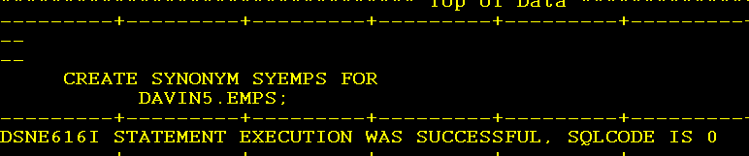
SYNONYM
Syntax
CREATE SYNONYM <syn name> FOR
<user id > . <table name>;
DAVIN5.EMPS can be referred as SYEMPS
If table is deleted, then synonym also will get deleted

Slide 54
ALIASES
An alternative name for a table or view.
Mainly to hide qualifier of a table
Can be accessible creator as well as any user
to whom the privilege is granted
It is not dropped when table / table space is
dropped Aliases name can only be used to
refer to objects across different sub sytems.

Slide 55
ALIASES
Alias.
An alternate name that can be used in SQL statements to refer to a table or view in the same or a remote DB2 subsystem
CREATE ALIAS TESTTAB FOR locationname.userid.EMP;
Notes:
these are alternate names for tables and views. Synonyms can only used to refer to
objects that exist locally, but aliases can be used to refer to remote objects as well as local
objects.
Synonym. In SQL, an alternative name for a table or view. Synonyms can only be used
to refer to objects at the substem in which the synonmy is defined.
Alias. An alternate name that can be used in SQL statements to refer to a table or view
in the same or a remote DB2 subsystem.
An alias, like a synonym, is a DB2 object that represents a table or a view. Unlike a
synonym, an alias can represent remote tables and views, and it can be used by anyone,
not just its creator. In addition, you do not need DB2 authority to use it. However,
you must have authority to use the table or view that it represents.
A reference to an alias could a one-two, or three-part name. The rules are basically the
same as those used to refer to a table or view.
A one-part name refers to a local alias. If the statement being executed is dynamic, the
owner of the alias is your current SQL authorization ID. Otherwise, it is the value
specified on the AQUALIFIER bind option. If a value is not specified on the
QUALIFIER bind option, then the owner of your package or plan is the qualifier of the
alias.
Example : A reference to EMP in a n interactively executed query could refer to the
alias SMITH.EMP if your current SQL authorization ID is SMITH.
A two-part name also refers to a local alias. As is true for a table or view, the first
qualifier identifies the owner.
Example : JONES.NEWTAB could refer to an alias named NEWTAB and owned by
JONES.
A three-part name could refer to either a local or a remote alias. As is true for a table or
view, the first qualifier specifies the location, and the second qualifier identifies the
owner. If the alias is remote, it must represent a table or view at its own location.
Example : A statement issued at the SAN_FRANCISCO subsystem refers to an alias at
DALLAS. The alias referred to must represent a table or view at DALLAS and
nowhere else.
Assume now that the alias SMITH.DALEMP has been defined at your local subsystem
for the table DALLAS.DSN 8230.EMP. You could then substitute the alias for this
table name. The result would look like this :
SELECT LASTNAME, MIDINIT, FIRSTNME, EMPNO, WORKDEPT FROM
SMITH.DALEMP
WHERE LASTNAME LIKE ‘%SON’;
An advantage to using a locally defined alias is that the SQL statements in which it
appears need not be changed if the table or view for the alias is either moved to another
location or renamed. To make these statements valid, drop the original alias and create
it again, and, for embedded SQL, rebind the program in which it appears.
The option of referencing a table or view by an alias or a synonym is not explicitly shown
in the syntax diagrams or mentioned in the description of SQL statements. Nevertheless,
an alias or a synonym can be used wherever a table or view can be referred to in an
SQL statement, with two exceptions: an alias cannot be used in CREATE ALIAS, and
a synonym cannot be used in CREATE SYNONYM. If an alias is used in CREATE
SYNONYM, it must identify a table or view at the current server. The synonym is
defined on the name of that table or view. If a synonym is used in CREATE ALIAS,
the alias is defined on the name of the table or view identified by the synonym.
The effect of using an alias or a synonym in an SQL statement is that of text substitution.
For example, if A is an alias or synonym for table Q.T, one of the steps involved in the
preparation of SELECT *FROM A is the replacement of ‘A’ by ‘A.T’ .
The differences between aliases and synonyms are a s follows :
SYSADM or SYSCTRL authority or the CREATE ALIAS privilege is required to
define an alias. No authorization is required to define a synonym.
An alias can be defined on the name of a table or view, including tables and
views that are not at the current server. A synonym can only be defined on the name of
a table or view at the current server.
An alias can be defined on an undefined name. A synonym can only be defined
on the name of an existing table or view.
Dropping a table or view has no effect on its aliases. But dropping a table or
view does drop its synonyms.
An alias is a qualified name that can be used by any authorization ID. A synonym
is an unqualified name that can only be used by the authorization ID that created it.
An alias defined at one DB2 subsystem can be used at another DB2 subsystem.
A synonym can only be used at the DB2 subsystem where it is defined.
When an alias is used, an error occurs if the name that it designates is undefined
or is the name of an alias at the current server. (Note, however, that the name can
designate an alias defined at another server if the alias represents a table or view at this
other server), When a synonym is used, this error cannot occur.

